Slide 1
Matchmaking & Call For Interest
User Manual

Slide 2
Content: User Manual
Registration Request – New user
Activate new user account
Access & Edit Matchmaking project data
“Call for Interest”
Navigation on the “Match-Making” platform
Adding new projects

Slide 3
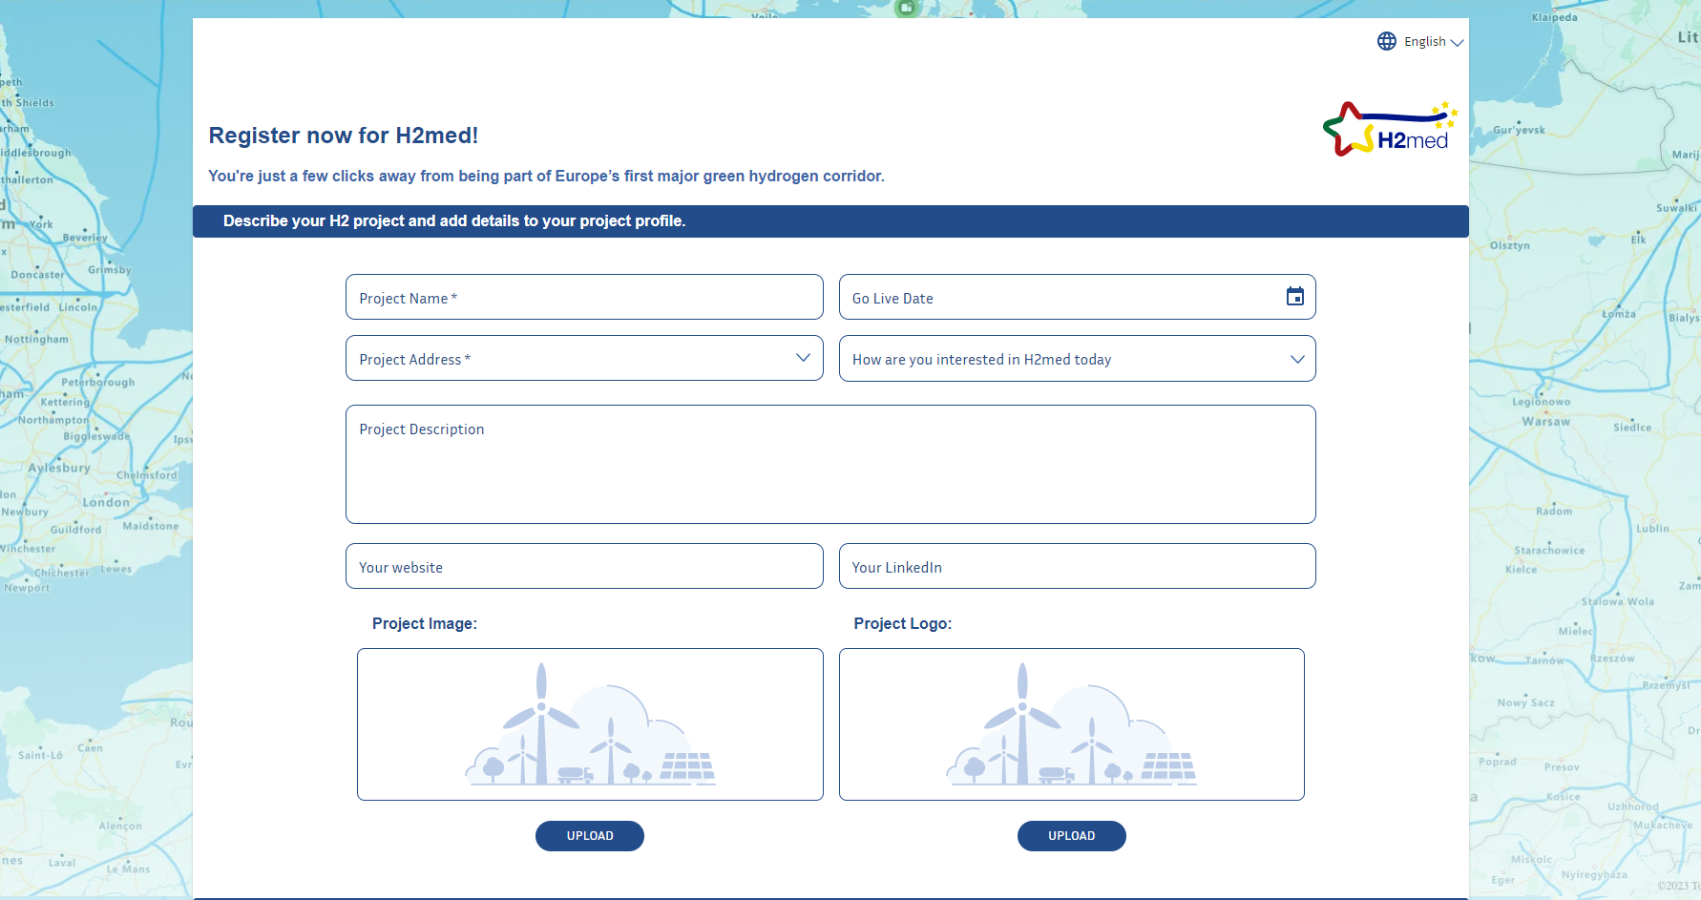
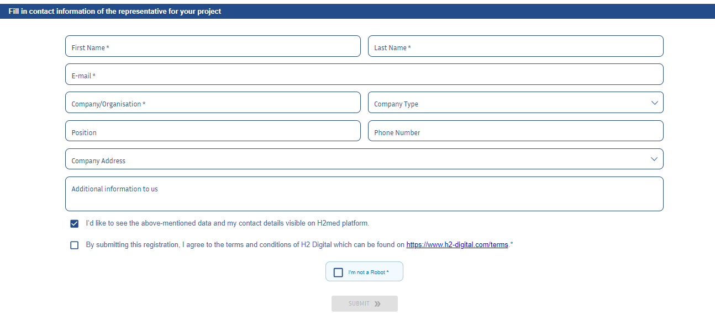
1. Registration Request - New user
Open the H2med registration form via www.h2-digital.com/h2med/join
To register as a new user, complete the registration form and provide details about the project you want to register.
  Key project fields: Project Name, Project Address and Commissioning Date.
  Key user information: Name, Company and Contact details.
To participate in the Matchmaking process, please select the tick box: “I’d like to see the above-mentioned data and my contact details visible on H2med platform.”
Submit the form to complete the registration process. An email confirming receipt of the registration request will be sent, please check spam folder.

Slide 4
2. Activate new user account
Once the account has been verified, the user receives an email indicating their new credentials to register on the H2med platform: www.h2-digital.com/h2med
Please monitor the spam folder, in case the email does not arrive to the Inbox.
When they activate their account, they will need to change the default password.

Slide 5
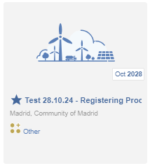
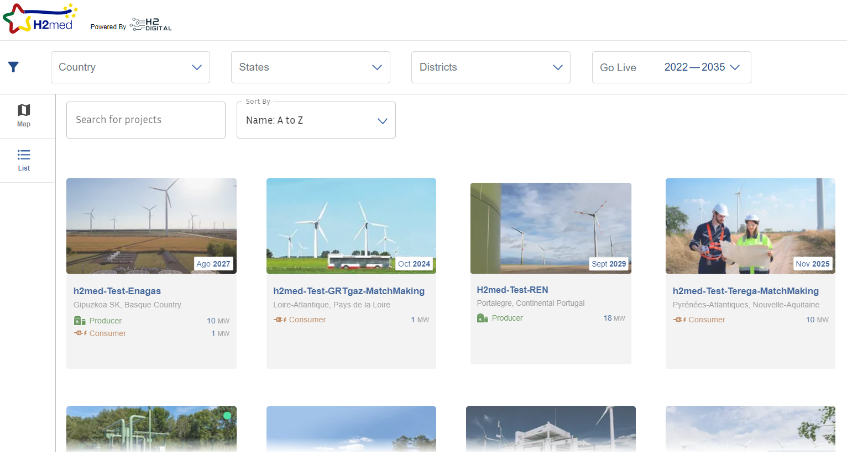
3. Access & Edit project data
If you selected to participate in the Matchmaking process, you will see all registered projects in the platform, your project(s) will appear marked with a star.
Otherwise, only your project(s) will be visible to you.
List View

Slide 6
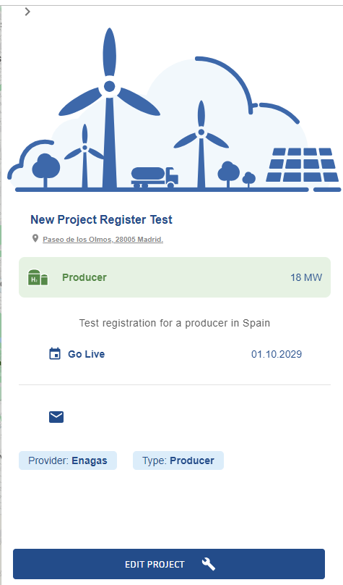
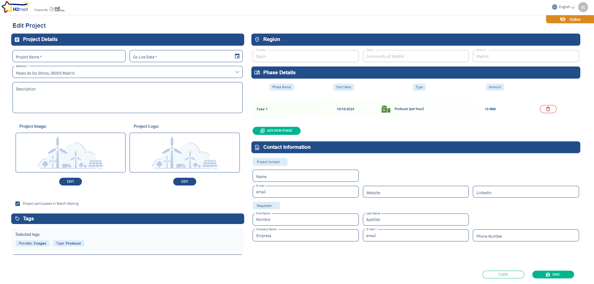
3. Access & Edit project data
From the platform, you can select your project(s) and edit the data associated with it by selecting “Edit Project”. This will take you to the page with all of your project data
Once the changes have been introduced, they will be approved by the TSO administrator before being reflected for other users. (Note changes won’t be reflected immediately).

Slide 7
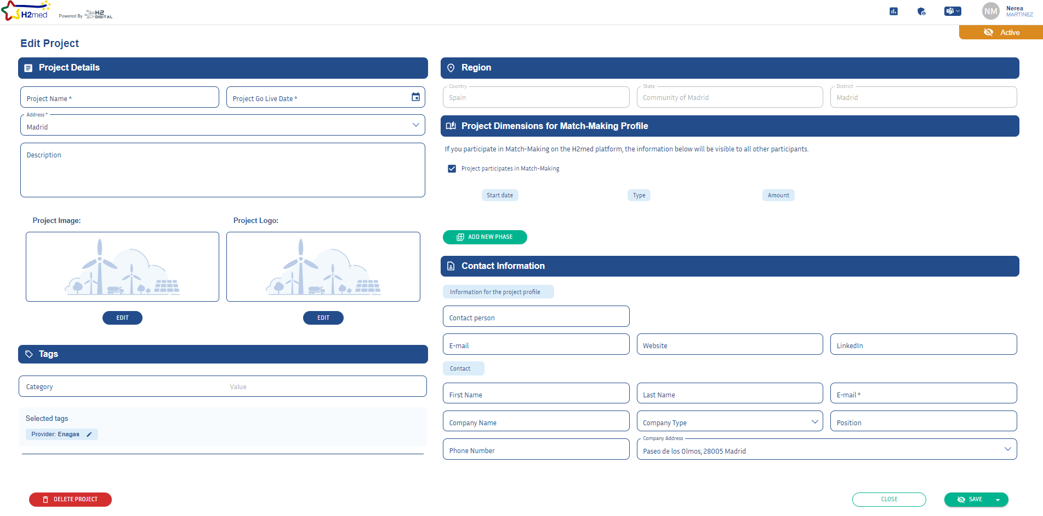
3. Edit Matchmaking project data
Project location selected in the registration application
Add project phases and dimensions – the default “Other” phase can be deleted and the relevant Producer / Consumer / Trader / Storage / CCUS
General project data
Enable other users to view the project by participating in “Match-Making”
Project contact details, for Matchmaking display
Lead user contact details, for TSO contact
Tags associated with the project, assigned at registration
Save changes

Slide 8
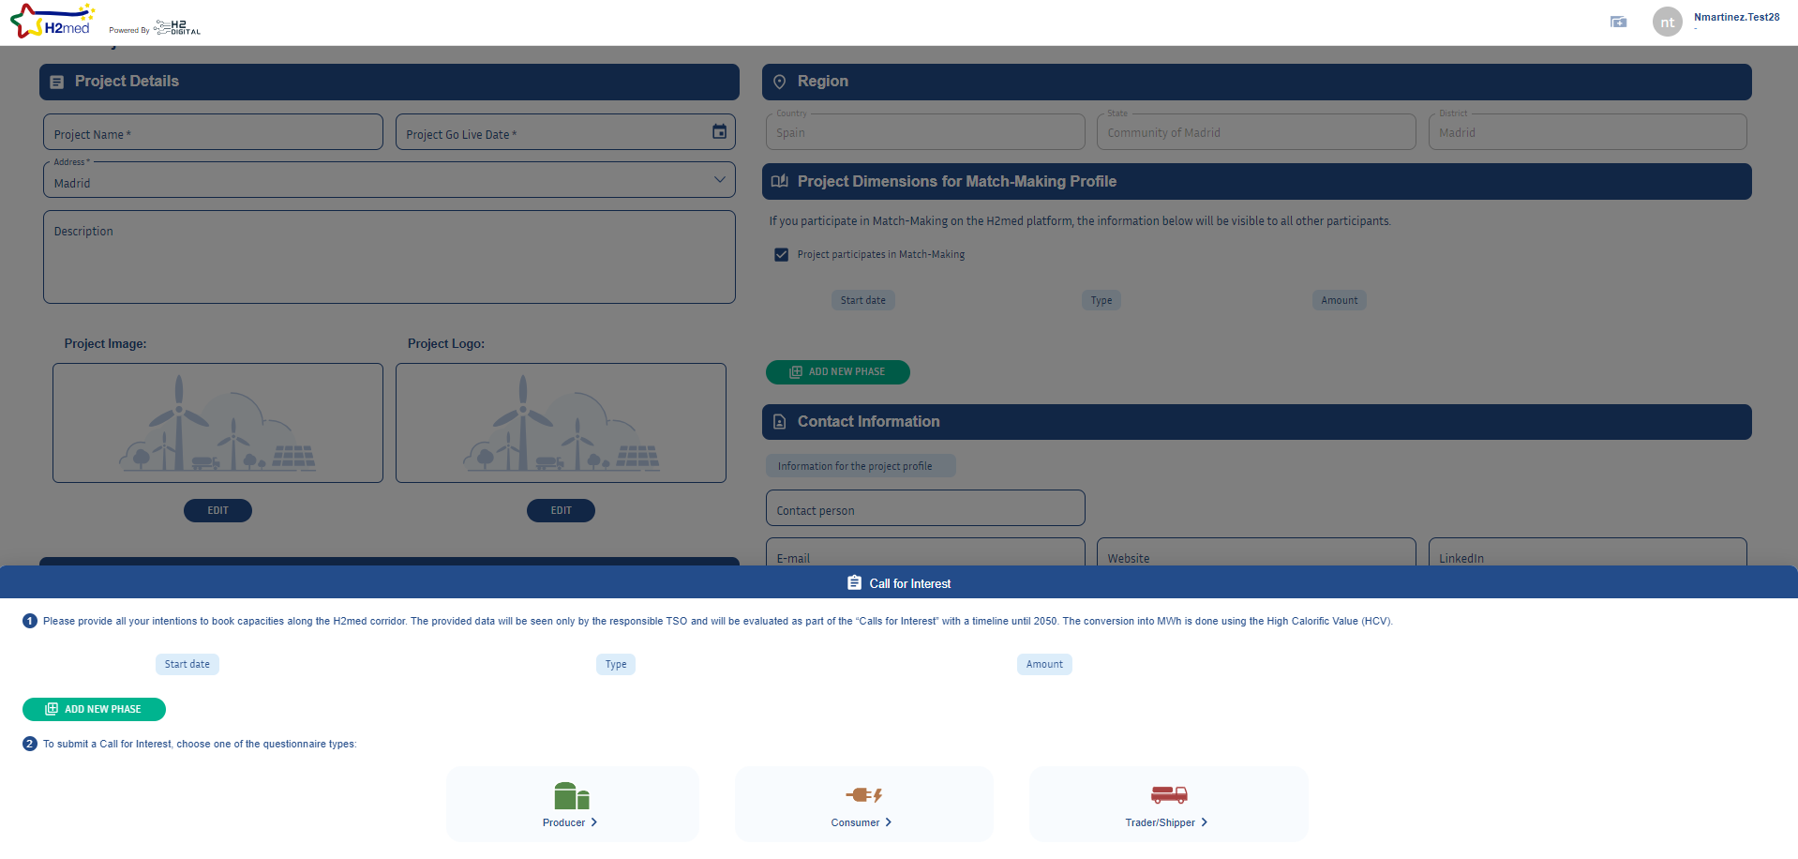
4. Completing the “Call for Interest”
To access the “Call for Interest”, navigate to the bottom of the project page.
The Call for Interest has two stages:
  Network booking intention
  Indicate the required interconnection capacity along the H2med corridor and national exit capacities.
  Questionnaires
  Select the one relevant to your project and complete accordingly (Producer/Consumer/Shipper).
Once you submit the questionnaire, you will receive a PDF copy with all your answers to the Call for Interest (Part 1 and Part 2 ).

Slide 9
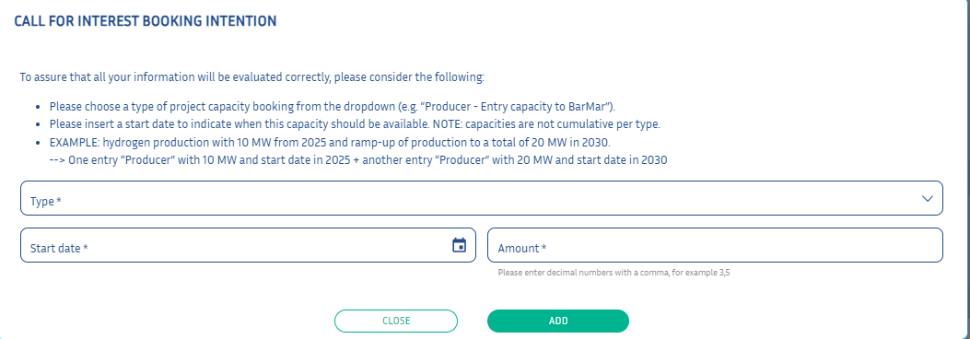
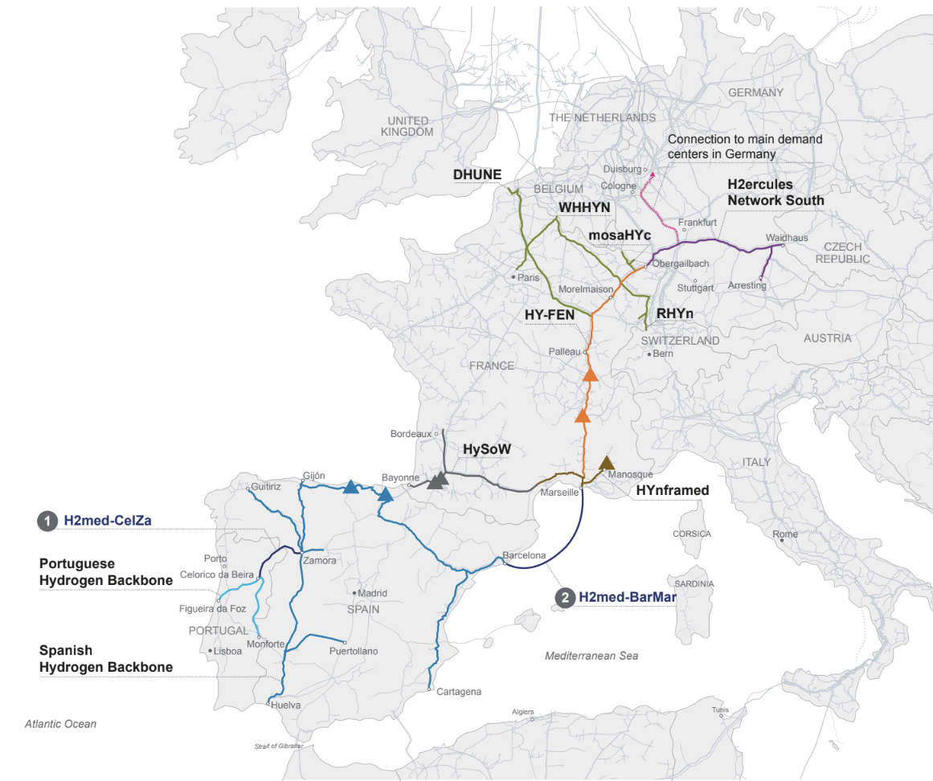
4. “Call for Interest” – Part 1: Network booking intention
Who books it?
5. Interconnection capacity at Medelsheim (France-Germany)
H2 producers in Portugal, Spain and France, consumers in Germany and shippers, intending to export through the Medelsheim interconnection point.
2. Exit capacity at Spanish backbone to supply domestic users
H2 producers in Portugal and Spain, consumers in Spain and shippers intending to book exit capacity for H2 within Spain.
5
To submit the network booking requirements, add the capacity volumes (tonnes) and start date required through each interconnection point and national exit capacity that will be required for the project.
4
4. Exit capacity at French backbone to supply domestic users
H2 producers in Portugal, Spain and France, consumers in France and shippers intending to book exit capacity for H2 within France.
CELZA capacity
H2 producers in Portugal and shippers exporting H2 through CELZA.
Examples: What capacity needs booking?
A) Portuguese H2 producer, exporting H2 to Germany
Booking interconnection points CELZA (1) + BARMAR (3) + France-Germany IP (5)
B) Spanish H2 producer, exporting H2 to France
Booking interconnection point BARMAR (3) + France national exit point (4)
1
2
3
3. BARMAR capacity
H2 producers in Portugal and Spain and shippers intending to export through BARMAR.

Slide 10

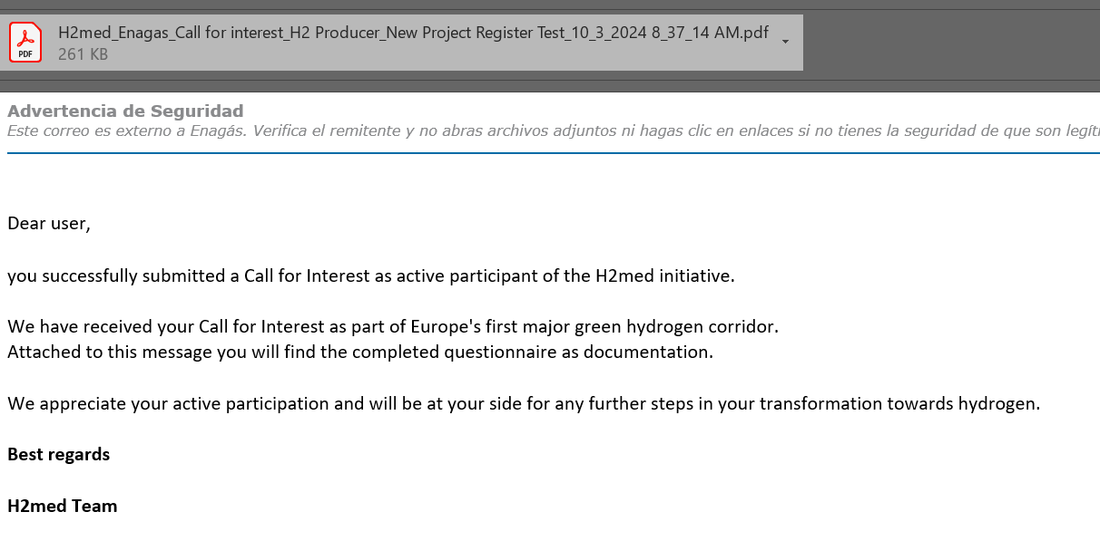
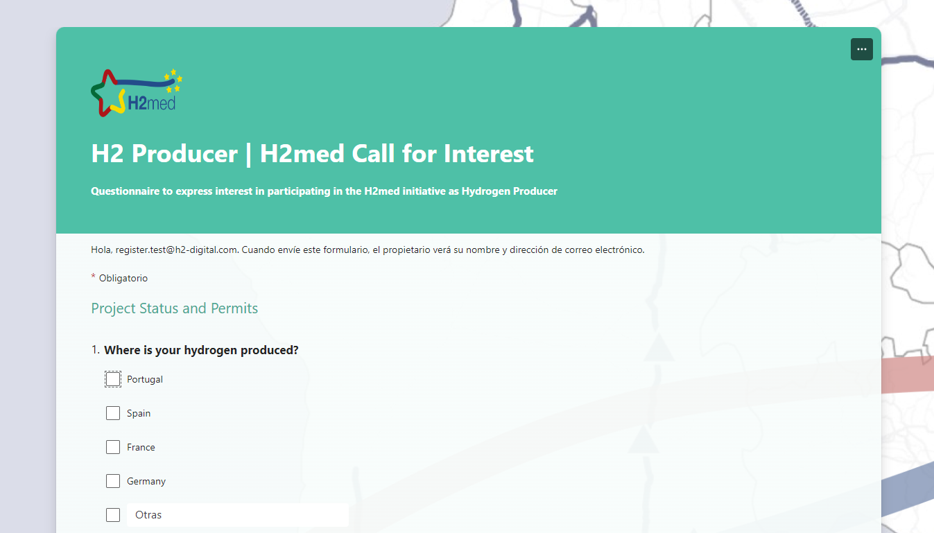
4. “Call for Interest” – Part 2: Questionnaires
To access the “Call for Interest” questionnaire, select the one relevant to your project and complete accordingly (Producer/Consumer/Shipper). The questionnaire will open in a new window.
After completing each relevant questionnaire, you will receive an email with a summary of the data provided.
You can complete the questionnaire again if you wish to modify information by repeating step 4.

Slide 11
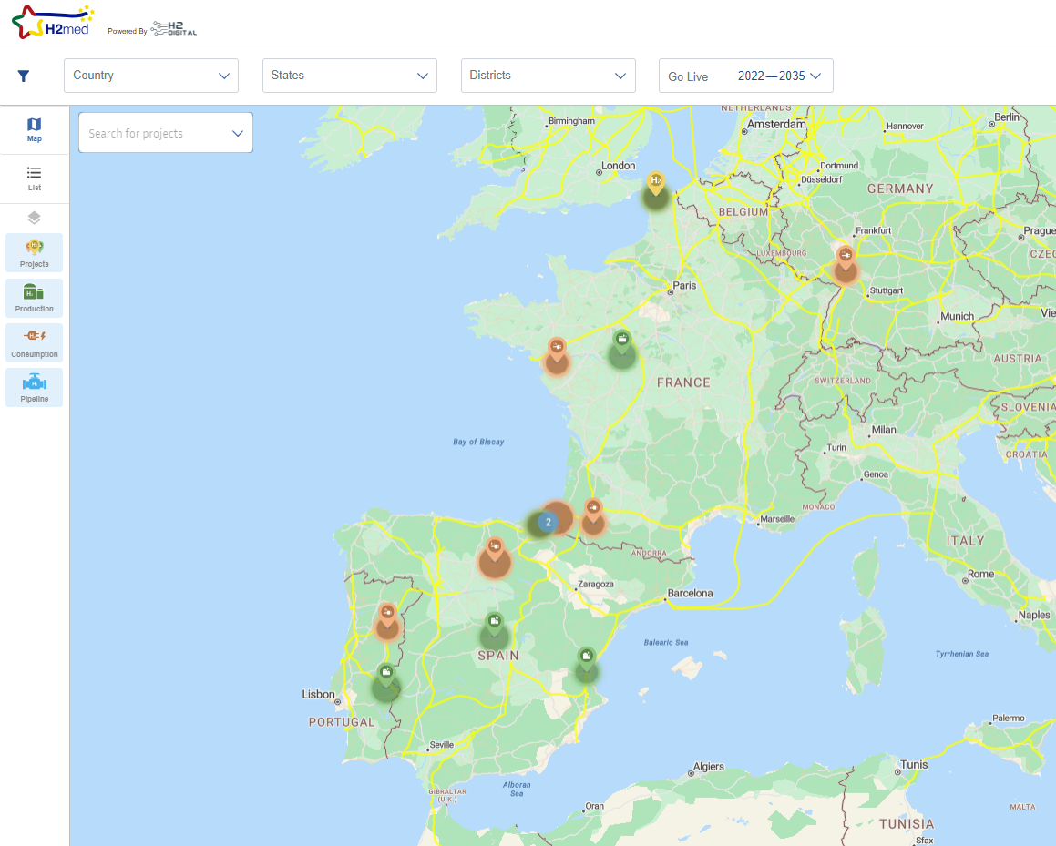
5. “Match-Making” Platform Navigation
Once the account is activated, the user will be able to see the data of the rest of the registered projects that have enabled the “Match-Making ” function (see step 3).
Projects can be viewed using a map view, or a list view, by selecting the mode in the left panel of the platform.
View on Map
List View

Slide 12
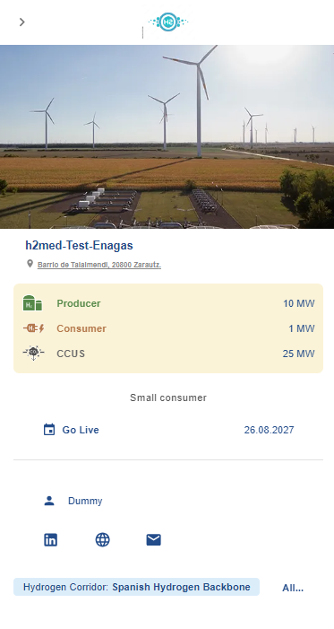
5. “Match-Making”
Platform Navigation
Once the account is activated, the user will be able to see the data of the rest of the registered projects that have enabled the “Match-Making ” function (see step 3).
Projects can be viewed using a map view, or a list view, by selecting the mode in the left panel of the platform.

Slide 13

6. Adding new projects
Once a user is registered in the platform, new projects developed by the same company can be added directly within the portal by selecting “Create new project” at the top right of the website.
For each new project, steps 3 (if participating in Matchmaking) and 4 should be repeated.

Slide 14
Contact Details
If you have any questions about the process, please contact us:
REN | h2ren@ren.pt
Enagás | h2medcfi@enagas.es
GRTgaz | blg-grt-h2medcfi@grtgaz.com
Térega | h2medcfi@terega.fr
OGE | h2-international@oge.net
The web form will be available from November 7th until December 6th, 2024.

