Slide 1
Guide for new entrants to the Gas System
February 2026

Slide 2
Table of Contents
Regulatory framework
Preliminary requirements for commencement of activity
Authorisation process
Access to the SL-ATR
Technical Accreditation

Slide 3

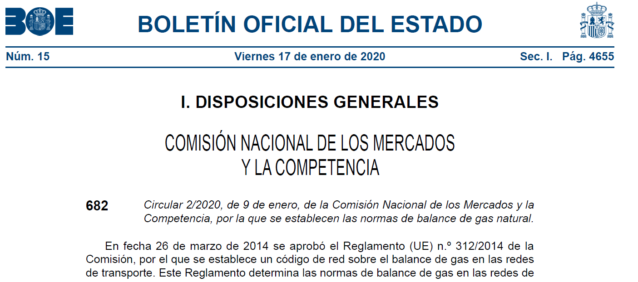
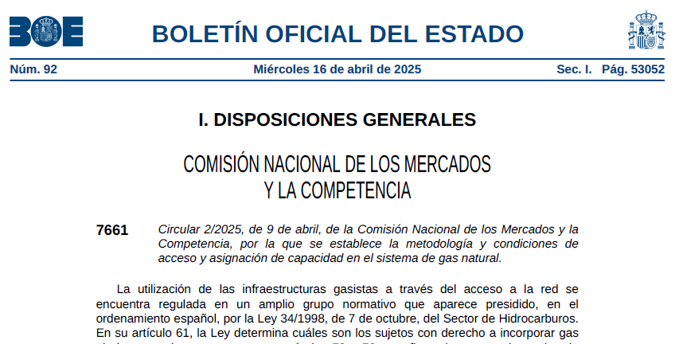
1. Regulatory framework
CNMC Circular 2/2020,
establishing the balancing rules for the gas system transmission network
Regulatory framework
CNMC Circular 2/2025,
establishing the methodology and conditions for access and capacity allocation in the natural gas system

Slide 4
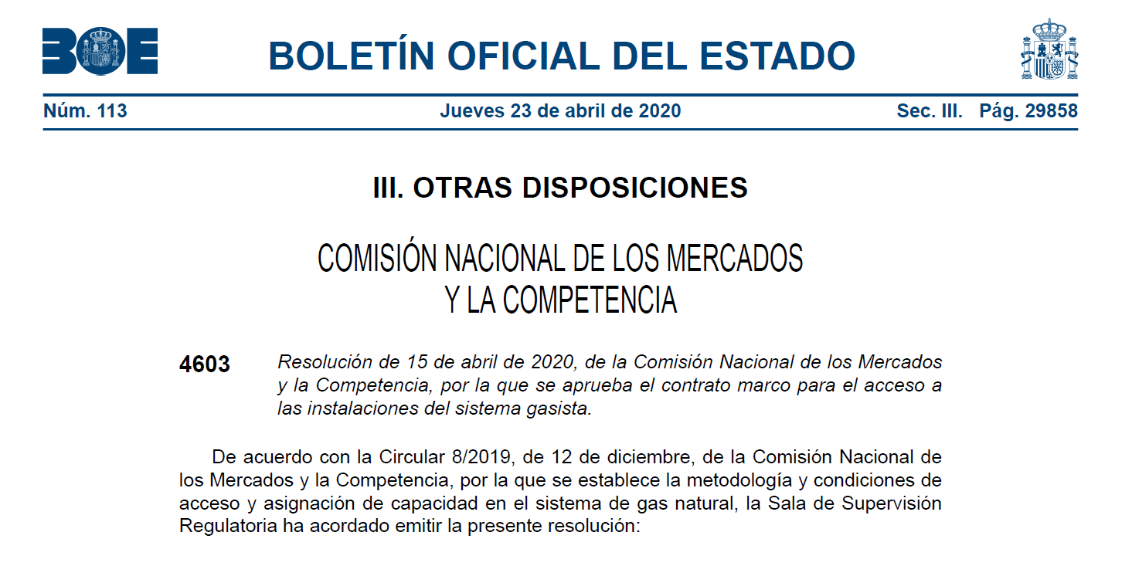
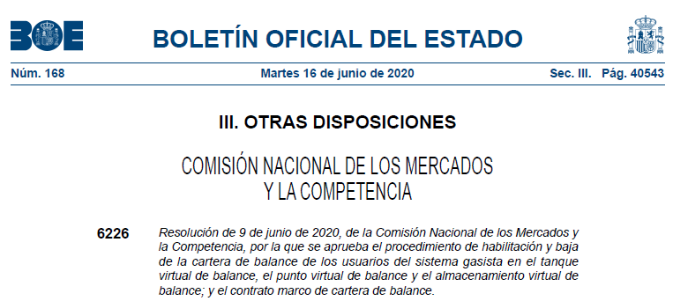
1. Regulatory framework
Resolution of 15 April 2020 (CNMC),
approving the framework agreement for access to the Spanish gas system facilities.
Regulatory framework
Resolution of 9 June 2020 (CNMC),
approving the Balancing Portfolio Framework Agreement.

Slide 5
Table of Contents
Regulatory framework
Preliminary requirements for commencement of activity
Authorisation process
Access to the SL-ATR
Technical Accreditation

Slide 6



2. Preliminary requirements for commencement of activity
Requirements for shipping natural gas:
Notification in writing, prior to commencing the activity to the competent Administration, and in all circumstances to the Directorate General for Energy Policy and Mines of the Ministry for the Ecological Transition and the Demographic Challenge, specifying the territorial scope where the activity is to be performed, the commencement date, company name, postal address, telephone number, fax number, tax ID code, as well as an affidavit setting out that the company complies with all the established requirements in order to exercise its activity.
The templates for the affidavit and notification of commencement of activity are included in Directorate General of Energy Policy and Mines Resolution of 3 May 2010,BOE-A-2010-7657
Link of interest:
  https://energia.gob.es/gas/Requisitos/Paginas/comercializador.aspx

Slide 7


2. Preliminary requirements for commencement of activity
Allocation of the SIFCO Code:
After receiving notification from the Directorate General for Energy Policy and Mines, the CNMC provides an identification code to the Shipper that is commencing activity in Spain for managing its information in the Billing and Consumption of the Gas Sector Information System (SIFCO).
Link of interest:
  https://sede.cnmc.gob.es/listado/censo/4
Allocation of the EIC Code:
The Primary transmission companies and Shippers must request a unique identification code for reporting their information in the different gas and electricity energy markets in the national and international spheres. This code is called the “Energy Identification Code”.
Redeia provides a web application to the parties involved in the energy markets as support for this function.
Link of interest:
https://www.portalclientes.ree.es/#/office/codes-consult/table

Slide 8

2. Preliminary requirements for commencement of activity
User Registration in the Guarantees Account in MIBGAS:
The Guarantees Account User is that legal entity which, once the Acceptance and Accession to the Guarantee Management Standards of the Gas System (NGGSG) Document is signed, is linked to a Guarantees Account.
The formalities for registration as a Guarantees Account User are performed at MIBGAS, from their website, the contact email address for which is agentes@mibgas.es
Each Guarantees Account User has an Allocation Account for each of the activities for which it is registered, which continually records the amount formalised, the requirements of this activity and the balance of guarantees available.
The activities in whose guarantees GTS participates are Procurement and Imbalances:
  Guarantees for procuring capacity of infrastructures with regulated third-party access
  Guarantees for the settlement of PVB, TVB and AVB imbalances
Link of interest:
  https://www.mibgas.es/en/cccontent/become-guarantee-account-user

Slide 9

Table of Contents
Regulatory framework
Preliminary requirements for commencement of activity
Authorisation process
Access to the SL-ATR
Technical Accreditation

Slide 10







3. Authorisation process
Request for Accession to Framework Agreements:
The Framework Access Agreement for the Spanish Gas System Facilities (AISGE) is imperative for contracting the different services on the platform by parties.
The Balancing Portfolio Framework Agreement is imperative to have a balancing portfolio in the desired balancing areas:
TVB
AVB
PVB
Requests are to be made by email addressed to GTS.HABILITACIONYACCESO@enagas.es
The subject line must state: Authorising “Username” and include the corresponding documentation.

Slide 11

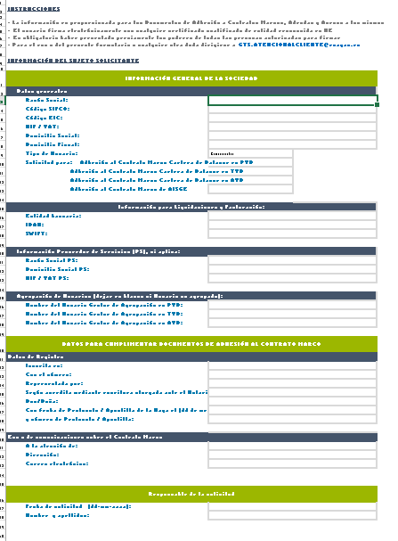
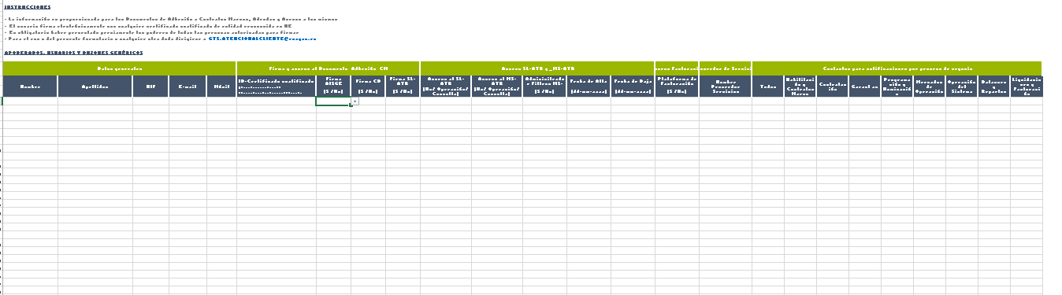
3. Authorisation process
Request for Accession to Framework Agreements:
The following documentation is required:
Request form, available on the GTS website.
Link of interest:
  https://www.enagas.es/en/technical-management-system/gas-system-processes/authorisation/

Slide 12

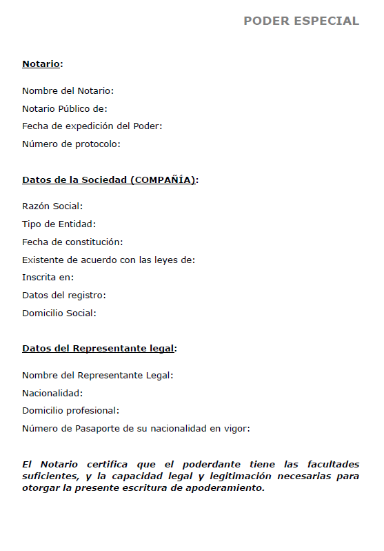
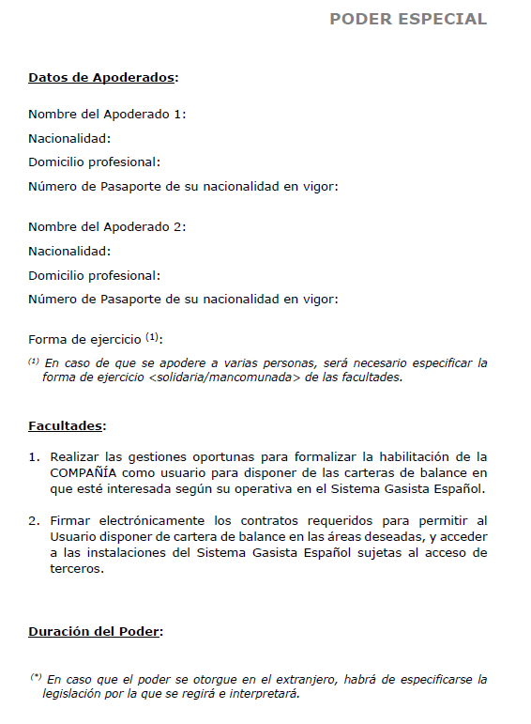

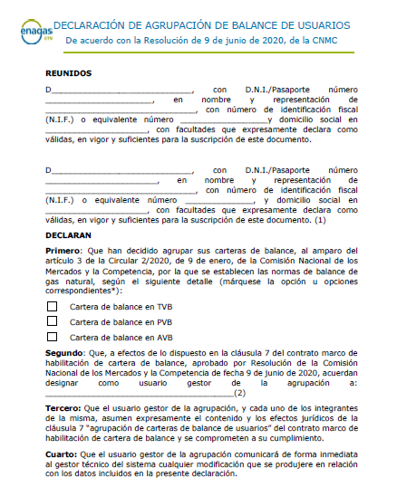
3. Authorisation process
Request for Accession to Framework Agreements:
Notary-witnessed power of attorney for company representatives, in Spanish.
  Copy of the sufficient, valid and current power/s of attorney of the person/s who are signatories to the Document of Accession to the Framework Agreement for access to facilities of the Spanish gas system.
  The Notary Public must certify that the attorney-in-fact has sufficient powers and the necessary legal capacity and standing to grant this power of attorney instrument.
  Should the power/s of attorney be in a language other than Spanish, a sworn translation must be submitted. Where the company is domiciled outside of Spain, this documentation must bear a Hague Apostille.
User Pooling Statement (Optional for Balancing Portfolio), available on the GTS website
Link of interest:
https://www.enagas.es/en/technical-management-system/gas-system-processes/authorisation/

Slide 13



3. Authorisation process
Request for Accession to Framework Agreements:
Certified
National Identity Card with a Hage Apostille (in the case of non-Spanish nationals) of:
Users with SL-ATR access
Signatories to the Framework Agreements
Users with access to the billing platform
Certificate of ownership of the bank account, issued by the bank in question

Slide 14

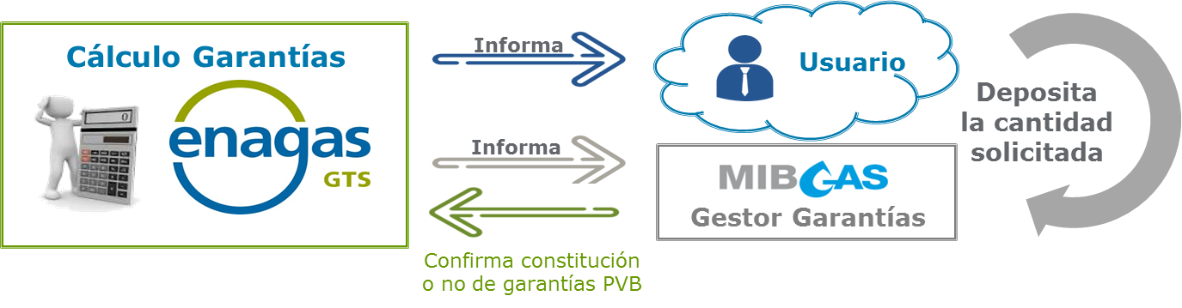
3. Authorisation process
Provision of guarantees to the Guarantee Manager:
Circular 2/2025 defines the minimum amount of the guarantee to be provided by any user to be authorised for Access to the Spanish Gas System Facilities at €50,000.
Circular 2/2020 defines the minimum amount of the guarantee to be provided by any user in order to qualify for the Balancing Portfolio at €100,000.
This requirement is permanent as long as the user is authorised.
Confirm arrangement of or lack of CB guarantee

Slide 15
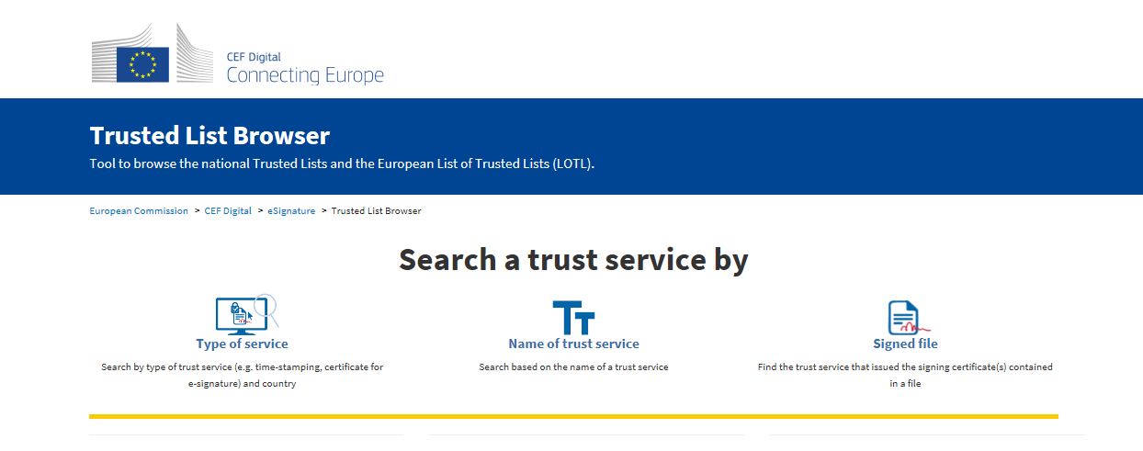
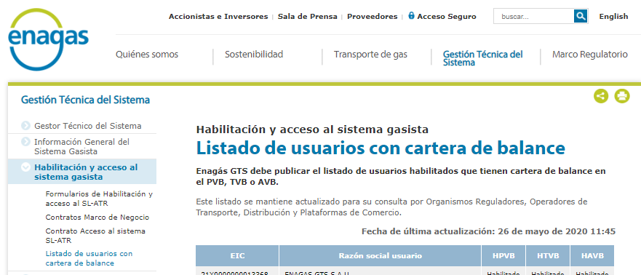
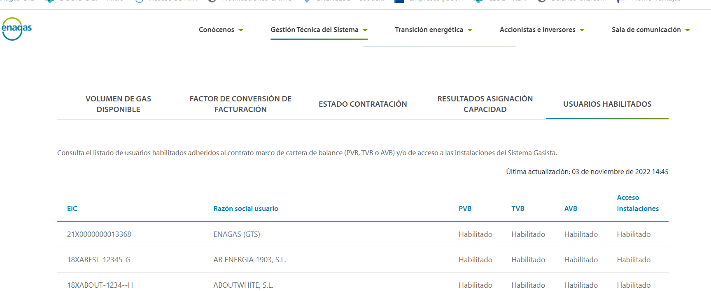

3. Authorisation process
Signing the Accession to the Framework Agreement document:
The user electronically signs the document of accession to the Framework Agreement, and may use any qualified certificate from an agency recognised in the EU, the list of which can be consulted by clicking on the following link:
https://eidas.ec.europa.eu/efda/tl-browser/#/screen/home
On its website, the GTS publishes the updated list of authorised users with a balancing portfolio
https://www.enagas.es/en/technical-management-system/energy-data/commercial-information/authorised-users/
and, in the SL-ATR, the updated list of authorised users with Access to the Facilities
in order to inform:
  Regulatory Bodies
  Distributors
  Transmission companies
  Trading Platform Operators

Slide 16
Table of Contents
Regulatory framework
Preliminary requirements for commencement of activity
Authorisation process
Access to the SL-ATR
Technical Accreditation

Slide 17

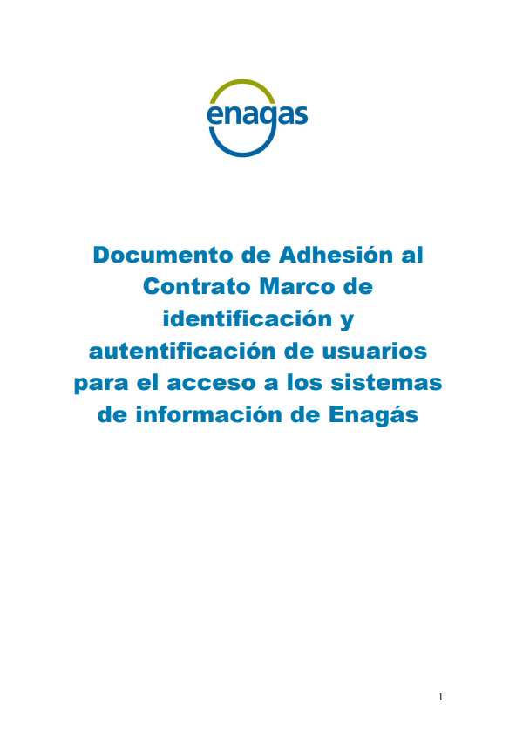
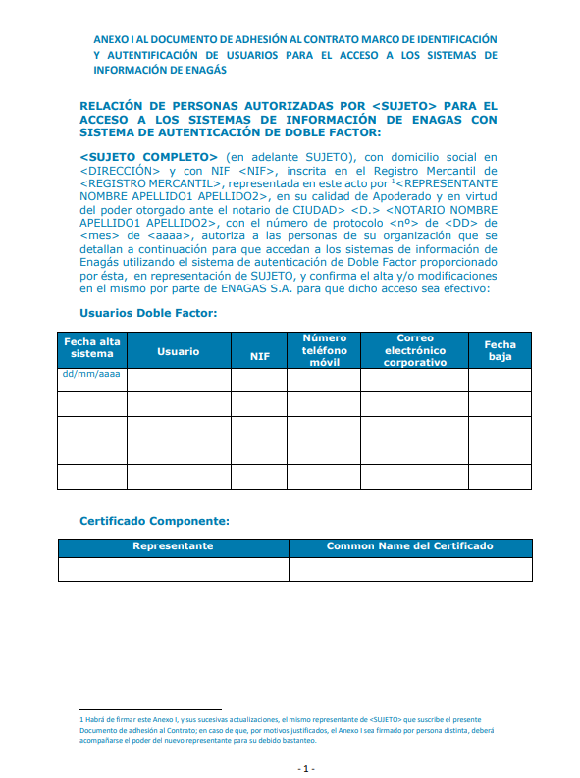
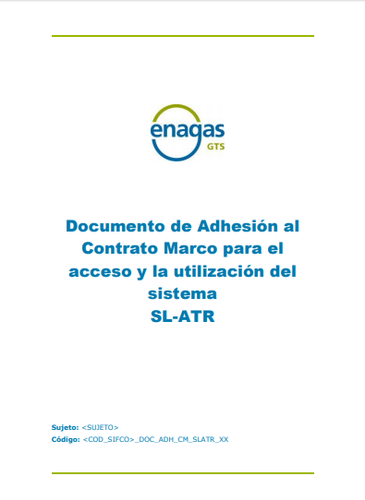
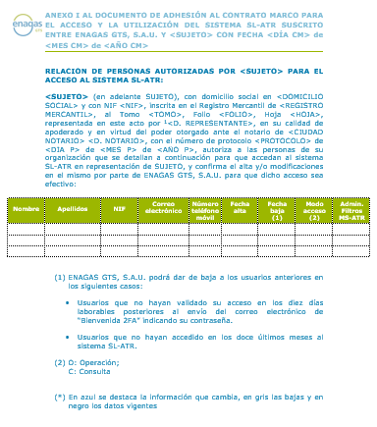

4. Access to the SL-ATR
  The various parties involved in the gas system are able to access the Third-party Access Logistics System (SL-ATR), a seamless, real-time communication tool that provides management support for the complete natural gas cycle. This system deals with requests for capacity, procurement, scheduling, nominations, measurements, distribution, balances and consultation of settlement surcharges through imbalances.
  To access this system, users must sign two documents for accession to the following framework agreements:
  Framework agreement for identification and authentication of users for access to the Enagás information systems
  Framework Agreement for access and use of the SL-ATR system

Slide 18

4. Access to the SL-ATR
Requesting access to the SL-ATR:
The initial request for access is to be sent by email to GTS.HABILITACIONYACCESO@enagas.es, attaching the actual Authorisation Form with the “Access to the SL-ATR” option.
Link of interest:
  https://www.enagas.es/en/technical-management-system/gas-system-processes/authorisation/
Any change concerning information of data and access permissions of SL-ATR users is to be reported through the Users with access to the SL-ATR modification form The form must include the information previously submitted as well as the users previously registered and, if applicable, deregistered
Link of interest:
  https://www.enagas.es/en/technical-management-system/gas-system-processes/authorisation/

Slide 19
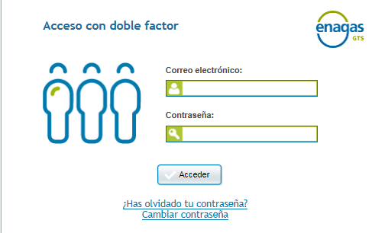
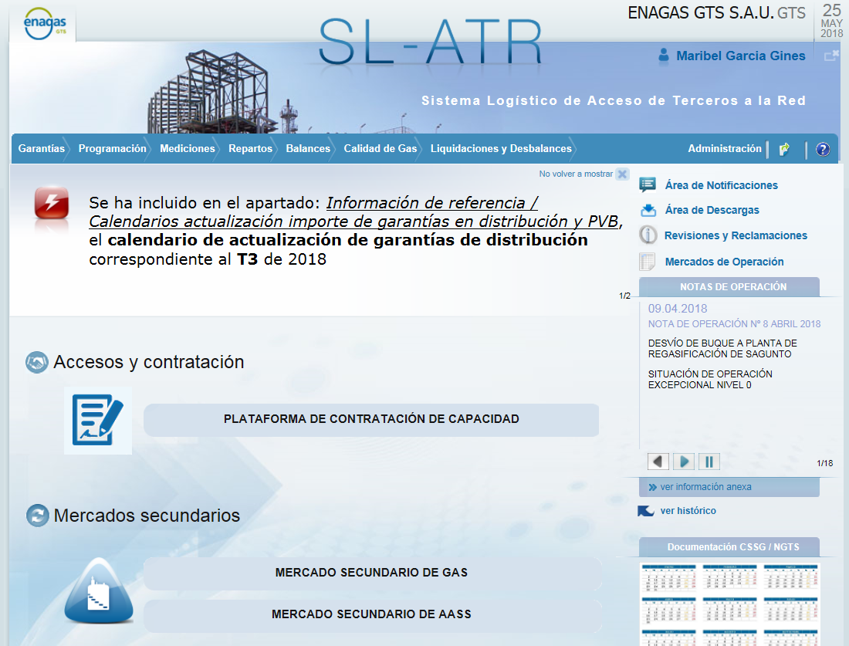
4. Access to the SL-ATR
Access to the SL-ATR via Double Factor:
Required information
  Mobile phone number, identity document number and email address
  Profile management
  Send welcome pack (user guide)
Authentication process
  Installation of advanced authentication app
  Introduce code received by SMS
  Scan QR code
Access to the
SL-ATR
  Introduce email and password on website
  Send request to mobile phone
  Validation of request in the app
Link of interest:
Access to the SLATR. 2FA User Guide

Slide 20
Table of Contents
Regulatory framework
Preliminary requirements for commencement of activity
Authorisation process
Access to the SL-ATR
Technical Accreditation

Slide 21

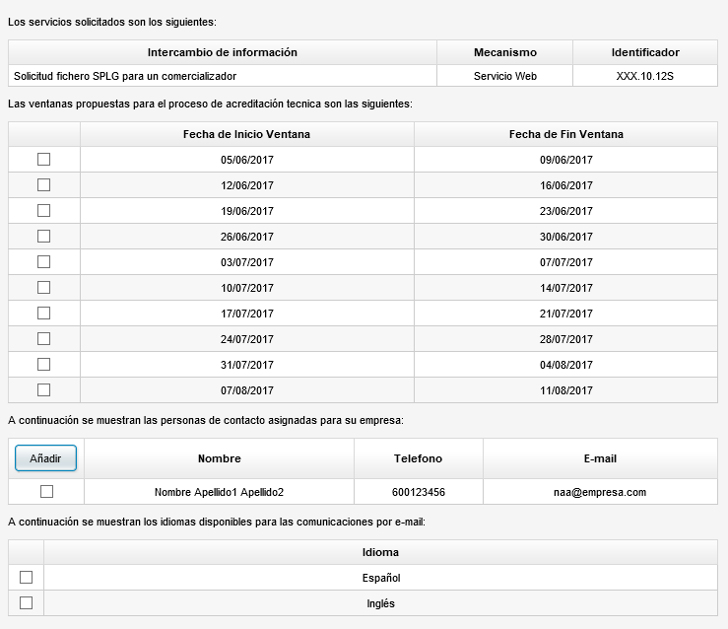
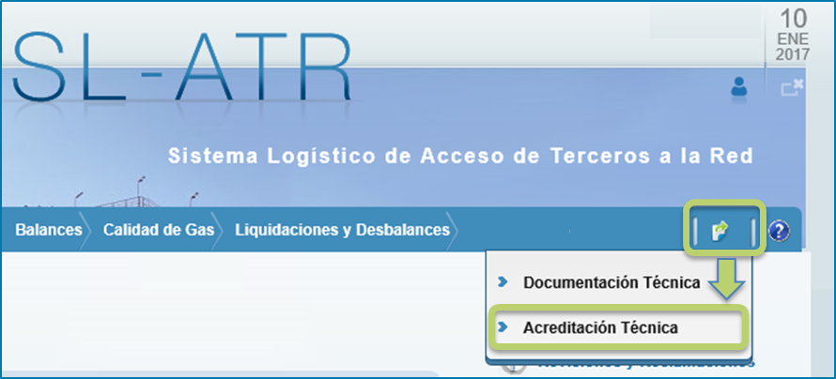

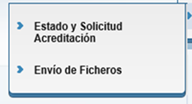

5. Technical Accreditation
  This certifies the technical ability to perform exchanges of XML files through the website services or via an app.
  It is an essential condition for sending files through the SL-ATR
  The party sending a request for an accreditation certificate through the SL-ATR, must request it in the Status and Request Accreditation option.
  Select one of the available test windows for accreditation.
  The test window can be modified through the app with its automatic update function. Send and email to acreditaciontecnica@enagas.es to request a window different to those available.
Accept

Slide 22
Thank you
very much

